Slide 1


CS 6831 Designing Secure Cryptography
Tom Ristenpart

Slide 2
Randomized symmetric encryption
Randomized encryption
Definitions: IND$, IND-CPA, IND-SIM
OCB core
CTR mode
CBC mode
Deficiencies in face of active attacks

Slide 3
CPA-core of OCB mode
Tweakable block ciphers can fix all this!
Let N be an n-bit nonce (only use once)
and use XE mode (or other suitable tweakable BC):
M1
M2
M3
C1
C2
C3
Remember our tweakable block cipher mode XE:

Slide 4
Randomized encryption
Symmetric encryption scheme is tuple
(randomized) key generation
(randomized) encryption
(deterministic) decryption
Assume length of ciphertext determined solely by length of message: clen(|M|)

Slide 5
Real-or-random indistinguishability
Can’t distinguish from random bits under chosen-message attack
Adversary can repeatedly query Enc on same message

Slide 6
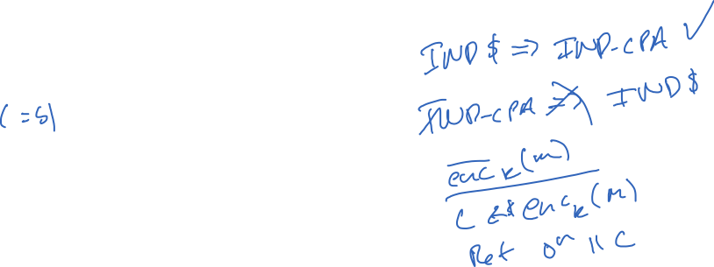


IND-CPA (indistinguishability under chosen-plaintext attack)
Can’t infer which of two messages encrypted
Queries must be such that |M₀| = |M₁|
What is relationship between IND-CPA and IND$?

Slide 7
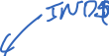

Slide 8
Simulation-based security
Having ciphertext is as good as not having ciphertext.
S is called a simulator. Randomized algorithm
What is relationship between IND-CPA, IND-SIM, and IND$?
Showing security: give S for which advantage low for any efficient A
Showing insecurity: give A for which advantage high for any efficient S

Slide 9

IND$ => IND-SIM

Slide 10
CPA definitions recap
Many ways to define confidentiality under chosen-plaintext attack (CPA) for symmetric encryption
IND-CPA is classic one
Inherited from asymmetric encryption literature
IND$ is used widely too
Generally both easier to work with and strictly stronger
IND-SIM is not as widely used
Introduced pedagogical purposes: introduction to simulator-based defs
We’ll see that CPA is not nearly strong enough for practical use
But useful conceptual and technical building block

Slide 11

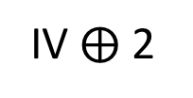
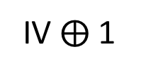
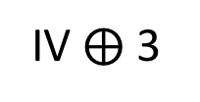
CTR mode from a block cipher
IV $⨁$ 1
IV $⨁$ 2
IV $⨁$ 3
IV is random 128 bit value
E_{K}
E_{K}
E_{K}
P1
P2
P3
M1
M2
M3
C1
C2
C3
Key generation simply picks random k-bit key

Slide 12
IND$ of CTR mode
Proof is tight: attack that recovers partial plaintext data with q $≈$ 2^{n/2}
Proofs of similar results in Boneh-Shoup (Thm 5.3) & Bellare-Rogaway (Thm 5.14)

Slide 13
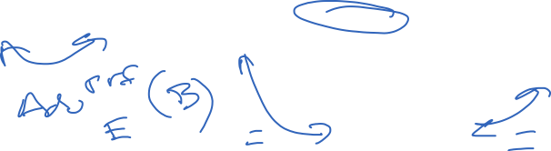


Slide 14
Notes:
If mi < 2n − 1 for all queries then we can ignore wraparound effects, and so no collisions on each row.
Now consider any two pairs of rows 1 < i < j.
We can consider IVi to be fixed, and so a collision across rows occurs if
IVj ∈ {IVi + α : −σ + 1 ≤ α ≤ σ − 1}.
This occurs with probability (2σ − 1)/2n.
Since there are at most q2 such pairs,
we have that the total probability of a collision is at most 2q2σ/2n.

Slide 16





Slide 17



CFB mode
Ciphertext feedback mode (CFB)
Pad message M to M[1],M[2],M[3],... where each block M[i] is n bits
Choose random n-bit string IV
Then:
IV
E_{K}
E_{K}
E_{K}
M[1]
M[2]
M[3]
C0
C1
C2
C3
How do we decrypt?

Slide 18
OFB mode
Offset feedback mode (OFB)
Pad message M to M[1],M[2],M[3],... where each block M[i] is n bits
Choose random n-bit string IV
Then:
IV
E_{K}
E_{K}
E_{K}
M[1]
M[2]
M[3]
C0
C1
C2
C3
How do we decrypt?

Slide 19


CBC mode for block cipher
How do we do padding?
IV is random 128 bit value
M₁
M₂
M₃
IV
E_{K}
E_{K}
E_{K}
C₀
C₁
C₂
C₃
Can prove similar bounds for CBC mode with similar birthday-bounds loss

Slide 20

Active attack example: session handling and login
GET /index.html
Set-Cookie: AnonSessID=134fds1431
POST /login.html?name=bob&pw=12345
Protocol
is HTTPS.
Elsewhere else just HTTP.
Nowadays increasingly all HTTPS
Cookie: AnonSessID=134fds1431
Set-Cookie: SessID=83431Adf
GET /account.html
Cookie: SessID=83431Adf

Slide 21
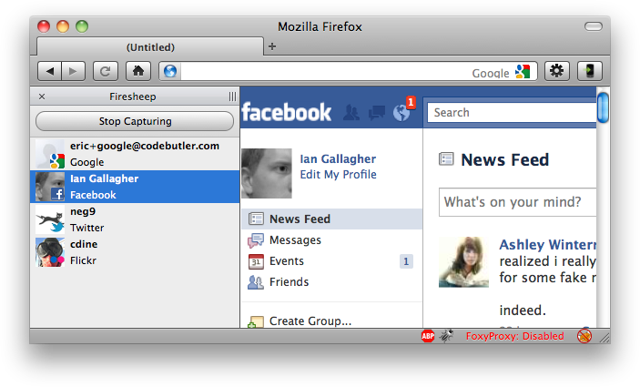
Session Hijacking
From http://codebutler.com/firesheep

Slide 22

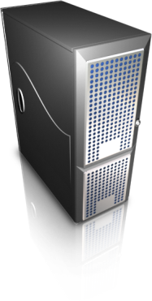
Security problems here?
Facebook.com
POST /login.html?name=bob&pw=12345
Cookie: AnonSessID=134fds1431
Set-Cookie: SessID=83431Adf
Secret key K only known to server
GET /account.html
Cookie: SessID=83431Adf
83431Adf = CTR-Enc(K, “admin=0”)
Malicious client can simply flip a few bits to change admin=1

Slide 23
CBC mode has “malleability” issues, too
M[1]
M[2]
M[3]
IV
E_{K}
E_{K}
E_{K}
C0
C1
C2
C3
How do we change bits of M1 received by server??
M[1] ⨁ D
IV
For any D:
D_{K}
C0 ⨁ D
C1

Slide 24
Padding for CBC mode
CBC mode handles messages with length a multiple of n bits
We use padding to make it work for arbitrary encryption schemes
Padding checks often give rise to
padding oracle attacks

Slide 25
Simple situation: pad by 1 byte
M[1]
M[2]||P
Assume that
M[1]||M[2] has length
2n-8 bits
IV
E_{K}
E_{K}
P is one byte of padding
that must equal 0x00
C0
C1
C2
C0 , C1 , C2
ok
Adversary
obtains
ciphertext
C0,C1,C2
Dec(K, C’ )
M[1]’||M[2]’||P’ = CBC-Dec(K,C’)
If P’ ≠ 0x00 then
Return error
Else
Return ok
C0, C1⨁1 , C2
error

Slide 26
Simple situation: pad by 1 byte
M[1]
M[2]||P
Assume that
M[1]||M[2] has length
2n-8 bits
IV
E_{K}
E_{K}
P is one byte of padding
that must equal 0x00
C0
C1
C2
Low byte of M1 equals i
R, C0 , C1
error
R , C0⨁1 , C1
error
Adversary
obtains
ciphertext
C = C0,C1,C2
Let R be arbitrary
n bits
Dec(K, C’ )
M[1]’||M[2]’||P’ = CBC-Dec(K,C’)
If P’ ≠ 0x00 then
Return error
Else
Return ok
R , C0⨁2 , C1
error
…
R , C0⨁i , C1
ok

Slide 27
PKCS #7 Padding
PKCS#7-Pad(M) = M || P || … || P
P repetitions of byte encoding number of bytes padded
01
02 02
03 03 03
04 04 04 04
…
FF FF FF FF … FF
Possible paddings:
For block length of 16 bytes, never need more than 16 bytes
of padding (10 10 … 10)
Notes:
Examples on board

Slide 28
Decryption (assuming at most one block of padding)
Dec( K, C )
M[1] || … || M[m] = CBC-Dec(K,C)
P = RemoveLastByte(M[m])
while i < int(P):
P’ = RemoveLastByte(M[m])
If P’ != P then
Return error
Return ok
“ok” / “error” stand-ins for some other behavior:
Passing data to application layer (web server)
Returning other error code (if padding fails)

Slide 29
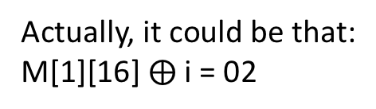
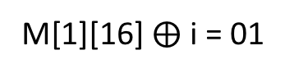
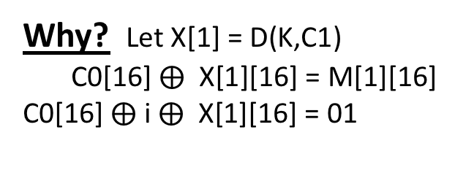
PKCS #7 padding oracles
Low byte of M[1] most likely equals i ⨁ 01
R, C0 , C1
error
R , C0⨁1 , C1
error
Dec( K, C )
M[1] || … || M[m] = CBC-Dec(K,C)
P = RemoveLastByte(M[m])
while i < int(P):
P’ = RemoveLastByte(M[m])
If P’ != P then
Return error
Return ok
Adversary
obtains
ciphertext
C = C0,C1,C2
Let R be arbitrary
n bits
R , C0⨁2 , C1
error
…
R , C0⨁i , C1
ok
Why? Let X[1] = D(K,C1)
C0[16] $⨁$ X[1][16] = M[1][16]
C0[16] $⨁$ i $⨁$ X[1][16] = 01
Actually, it could be that:
M[1][16] $⨁$ i = 02
M[1][16] $⨁$ i = 01
Implies that M[1][15] = 02
We can rule out with an additional query

Slide 30
PKCS #7 padding oracles
Second lowest byte of M[1] equals i ⨁ 02
R, C0 , C1
error
R , C0⨁1||j , C1
error
Dec( K, C )
M[1] || … || M[m] = CBC-Dec(K,C)
P = RemoveLastByte(M[m])
while i < int(P):
P’ = RemoveLastByte(M[m])
If P’ != P then
Return error
Return ok
Adversary
obtains
ciphertext
C = C0,C1,C2
Let R be arbitrary
n bits
R , C0⨁2||j , C1
error
…
R , C0⨁i||j , C1
ok
Set j = M[1][16] ⨁ 01 ⨁ 02

Slide 31
Can we change decryption implementation?
Dec( K, C )
M[1] || … || M[m] = CBC-Dec(K,C)
P = RemoveLastByte(M[m])
while i < int(P):
P’ = RemoveLastByte(M[m])
If P’ != P then
Return error
Return ok
“ok” / “error” stand-ins for some other behavior:
Passing data to application layer (web server)
Returning other error code (if padding fails)

Slide 32
Chosen ciphertext attacks against CBC
Attack | Description | Year
Vaudenay | 10’s of chosen ciphertexts, recovers message bits from a ciphertext. Called “padding oracle attack” | 2001
Canvel et al. | Shows how to use Vaudenay’s ideas against TLS | 2003
Degabriele, Paterson | Breaks IPsec encryption-only mode | 2006
Albrecht et al. | Plaintext recovery against SSH | 2009
Duong, Rizzo | Breaking ASP.net encryption | 2011
Jager, Somorovsky | XML encryption standard | 2011
Duong, Rizzo | “Beast” attacks against TLS | 2011
AlFardan, Paterson | Attack against DTLS | 2012
AlFardan, Paterson | Lucky 13 attack against DTLS and TLS | 2013
Albrecht, Paterson | Lucky microseconds against Amazon’s s2n library | 2016

Slide 33
Next class: authenticated encryption
How do we build symmetric encryption that resists active attacks?
Authenticated encryption
Confidentiality
Integrity

